Slide 1
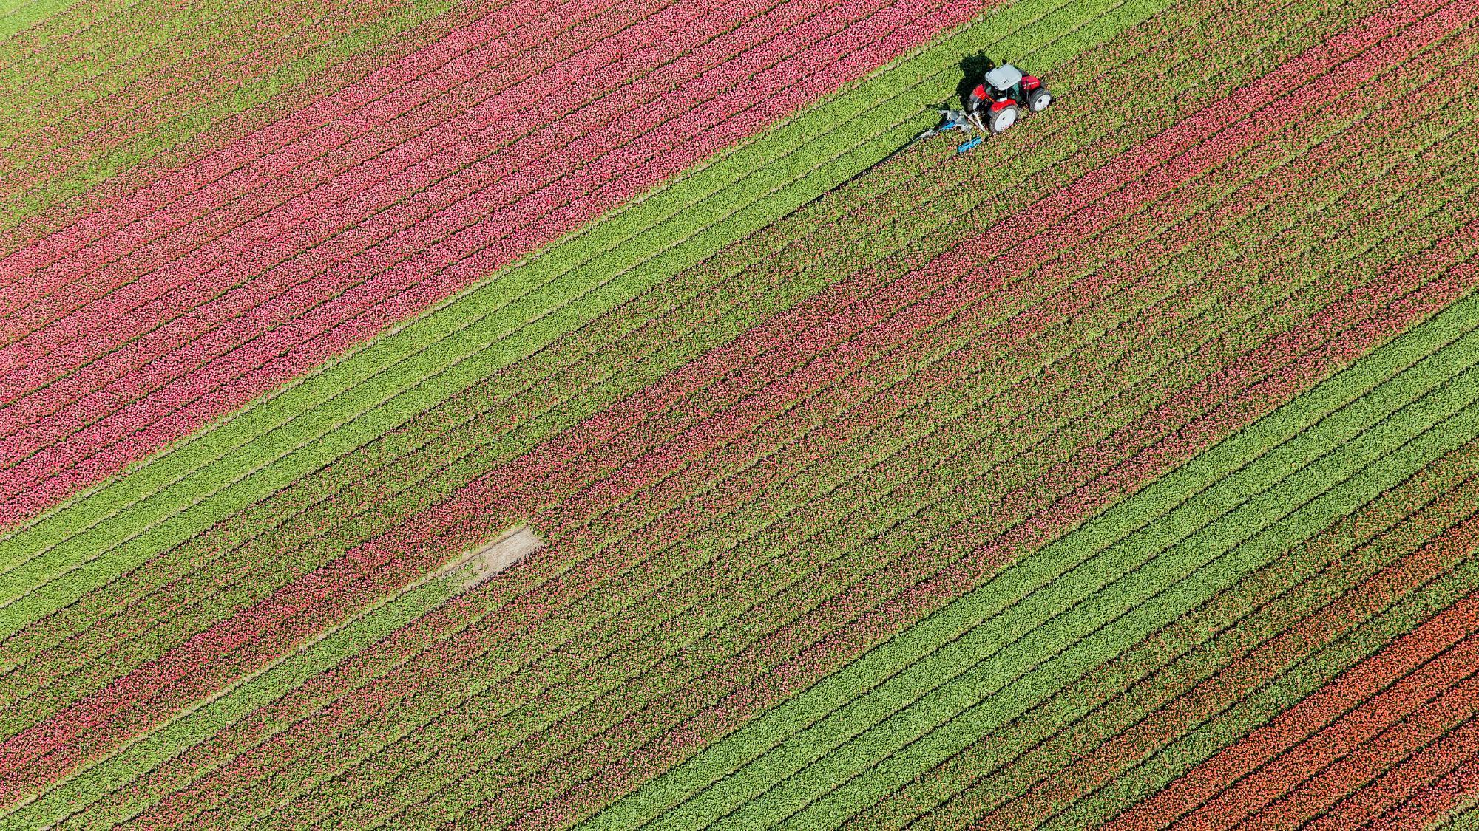
Encounters with Jesus 1:
The Woman of Samaria

Slide 2


Questions
What was really going on here?
Including historical or cultural context.
What was the turning point in Jesus’
conversation with the woman?
What does this teach us about Jesus/God?
What does this teach us about the people present, or humans generally?
Is there something here for
me to do?
Notes:
John 4:3–43 (ESV)
3 he left Judea and departed again for Galilee. 4 And he had to pass through Samaria. 5 So he came to a town of Samaria called Sychar, near the field that Jacob had given to his son Joseph. 6 Jacob’s well was there; so Jesus, wearied as he was from his journey, was sitting beside the well. It was about the sixth hour.
7 A woman from Samaria came to draw water. Jesus said to her, “Give me a drink.” 8 (For his disciples had gone away into the city to buy food.) 9 The Samaritan woman said to him, “How is it that you, a Jew, ask for a drink from me, a woman of Samaria?” (For Jews have no dealings with Samaritans.) 10 Jesus answered her, “If you knew the gift of God, and who it is that is saying to you, ‘Give me a drink,’ you would have asked him, and he would have given you living water.” 11 The woman said to him, “Sir, you have nothing to draw water with, and the well is deep. Where do you get that living water? 12 Are you greater than our father Jacob? He gave us the well and drank from it himself, as did his sons and his livestock.” 13 Jesus said to her, “Everyone who drinks of this water will be thirsty again, 14 but whoever drinks of the water that I will give him will never be thirsty again. The water that I will give him will become in him a spring of water welling up to eternal life.” 15 The woman said to him, “Sir, give me this water, so that I will not be thirsty or have to come here to draw water.”
16 Jesus said to her, “Go, call your husband, and come here.” 17 The woman answered him, “I have no husband.” Jesus said to her, “You are right in saying, ‘I have no husband’; 18 for you have had five husbands, and the one you now have is not your husband. What you have said is true.” 19 The woman said to him, “Sir, I perceive that you are a prophet. 20 Our fathers worshiped on this mountain, but you say that in Jerusalem is the place where people ought to worship.” 21 Jesus said to her, “Woman, believe me, the hour is coming when neither on this mountain nor in Jerusalem will you worship the Father. 22 You worship what you do not know; we worship what we know, for salvation is from the Jews. 23 But the hour is coming, and is now here, when the true worshipers will worship the Father in spirit and truth, for the Father is seeking such people to worship him. 24 God is spirit, and those who worship him must worship in spirit and truth.” 25 The woman said to him, “I know that Messiah is coming (he who is called Christ). When he comes, he will tell us all things.” 26 Jesus said to her, “I who speak to you am he.”
27 Just then his disciples came back. They marveled that he was talking with a woman, but no one said, “What do you seek?” or, “Why are you talking with her?” 28 So the woman left her water jar and went away into town and said to the people, 29 “Come, see a man who told me all that I ever did. Can this be the Christ?” 30 They went out of the town and were coming to him.
31 Meanwhile the disciples were urging him, saying, “Rabbi, eat.” 32 But he said to them, “I have food to eat that you do not know about.” 33 So the disciples said to one another, “Has anyone brought him something to eat?” 34 Jesus said to them, “My food is to do the will of him who sent me and to accomplish his work. 35 Do you not say, ‘There are yet four months, then comes the harvest’? Look, I tell you, lift up your eyes, and see that the fields are white for harvest. 36 Already the one who reaps is receiving wages and gathering fruit for eternal life, so that sower and reaper may rejoice together. 37 For here the saying holds true, ‘One sows and another reaps.’ 38 I sent you to reap that for which you did not labor. Others have labored, and you have entered into their labor.”
39 Many Samaritans from that town believed in him because of the woman’s testimony, “He told me all that I ever did.” 40 So when the Samaritans came to him, they asked him to stay with them, and he stayed there two days. 41 And many more believed because of his word. 42 They said to the woman, “It is no longer because of what you said that we believe, for we have heard for ourselves, and we know that this is indeed the Savior of the world.”
43 After the two days he departed for Galilee.

Slide 3
History
‘And he had to pass through Samaria.’
930BC Rebel northern Israelite kingdom. Idols.
722BC Israelites and Gentiles blended together.
~500BC Opposing reconstructions of Jerusalem.
~400BC Alternate temple built, while Judeans exclude Samaritans from Jerusalem temple.
128BC Conquered by the Judeans and Samaritan temple destroyed.
30AD Most Jews in Jesus’ time apparently walked around Samaria.
Notes:
Grab a flag pole or something to point at the map and the timeline with. Radio mic today?

Slide 4

Discovery Bible Study - John 4:3-43
Groups of 2 or 3. Mix up a bit.
What does this passage teach us about Jesus/God?
What does this passage teach us about the people present or humans generally?
Is there something here for me to do?
Notes:
Encourage people listening on the tape to take a few mins per question and jot down a few sentences before community group.

Slide 5

Feedback
What does this passage teach us about Jesus/God?
What does this passage teach us about the people present or humans generally?
Is there something here for me to do?
Notes:
What does this passage teach us about Jesus/God?
V4 He “had to” pass through Samaria; God is faithful to semi-faithful people!
V7 Our heavenly father does not forget anything or overlook anyone.
V38 Jesus has many labourers we do not know! These will have been involved in preparing some who later become disciples with us.
What does this passage teach us about the people present or humans generally?
v13-14 No good thing that God gives us will satisfy as deeply and eternally and God himself.
V16 Jesus always intended for the samaritan woman to be the person of peace who draws in others nearby her.
What was the turning point in Jesus’ conversation with the woman?
Is there something here for me to do?
Respond to every good thing God gives by connecting to him in thanksgiving.

Slide 6
Turning Points
Q: What was the turning point in Jesus’ conversation with the woman?
A whole conversation of turning points!
Initiating a chat and showing his openness to interact with samaritans. (v7)
Initiating a spiritual invitation. (v10)
Initiating a mission to be shared with more people from her village...and also showing he truly knew and had compassion on her. (v16)
Acknowledging her question but in a way that kept on track with his main point about her need for God. (v21-24)
Stayed with the people who wanted to here more (v

